Slide 1


SHOULD WE BE CONCERNED ABOUT AI TAKING OVER HUMAN JUDGEMENT?

Slide 2

TEAM MA05
Surabhi Modak
Adnan Yawar
MD Saadman Hossain
Wing(Whitney) Yeung
Chaojun(Wade) Xu

Slide 3

What is AI?

Slide 4
1921- science fiction play
The imitation game
01
03
Star wars
Facebook chatbots
02
04
History

Slide 5

Who are the stakeholders?
Health Organizations
Engineering and Product Development Teams
Human Resources
Legal
Union
Government
IT Professionals
Insurance companies
Automotive industry
General public

Slide 6
OUR EVOLUTION
Jupiter is a gas giant and the biggest planet
2005
2010
Saturn is composed of hydrogen and helium
Mercury is the closest planet to the Sun
2015
2020
Despite being red, Mars is a cold place

Slide 7
WHAT SETS US APART?
MARS
NEPTUNE
VENUS
Despite being red, Mars is actually a cold place. It’s full of iron oxide dust
Neptune is the fourth-largest planet in our Solar System
Venus has a beautiful name and is the second planet from the Sun

Slide 8
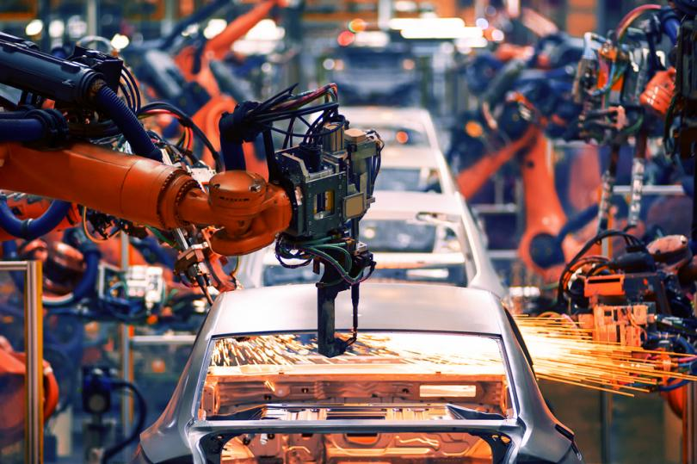
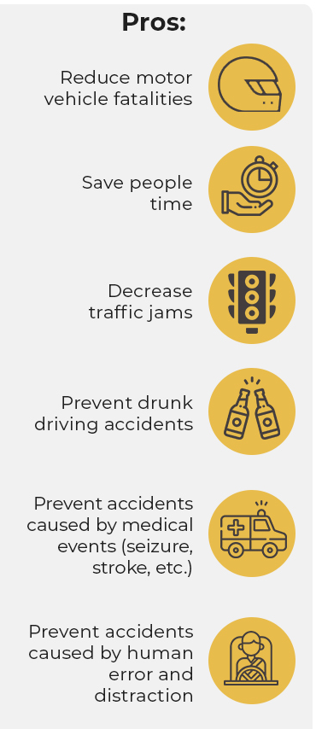
Some Positive aspects of AI in the automotive and machines industry
Top car manufacturers have embraced robotics and leaders in the automotive supply chain are embracing artificial intelligence (AI) to take on tasks such as quality control.
Some examples
Machinery lifespan determination - DataRPM’s machine learning technology
Self-driving cars- nuTonomy is creating autonomous technology for completely driverless vehicles.

Slide 9
Concerns & Consequences
Citizen Privacy Violations - Accurate data user portrait
Unemployment - machines replacing humans, book-keeping, receptionists, drivers etc.
Terrorist - Automatic weapons
Drivers - Automation makes the usability of self-driving cars at high-risk
In 2018, Uber self-driving car hit a pedestrian who later died. After the investigation, prosecutors have decided that the company is not criminally liable for the pedestrian’s death. This is because the safety driver was distracted with her cell phone, and police reports label the accident as “completely avoidable.”

Slide 10
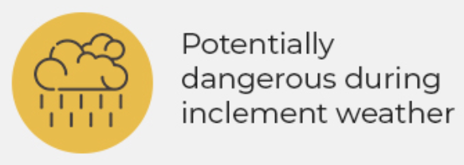
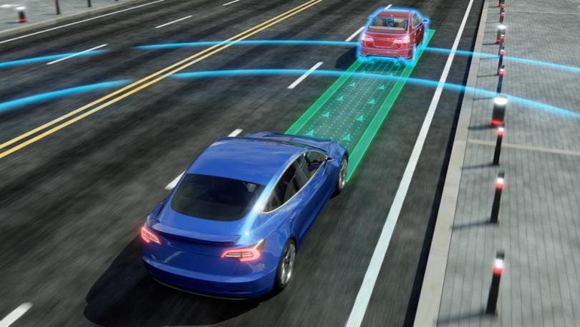
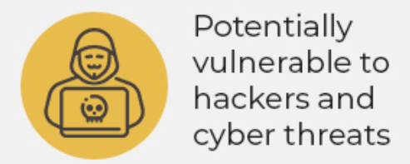
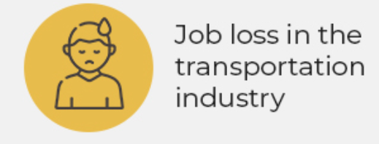
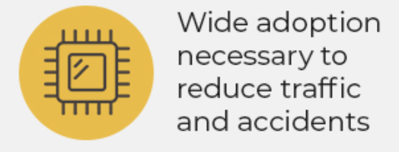
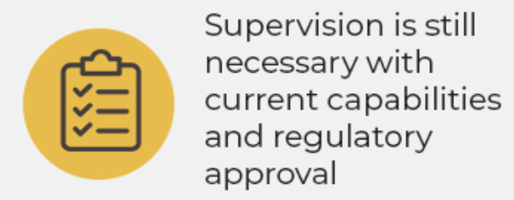
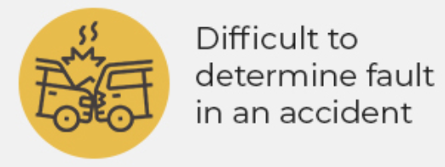
Concerns of AI use in the Automotive industry

Slide 11
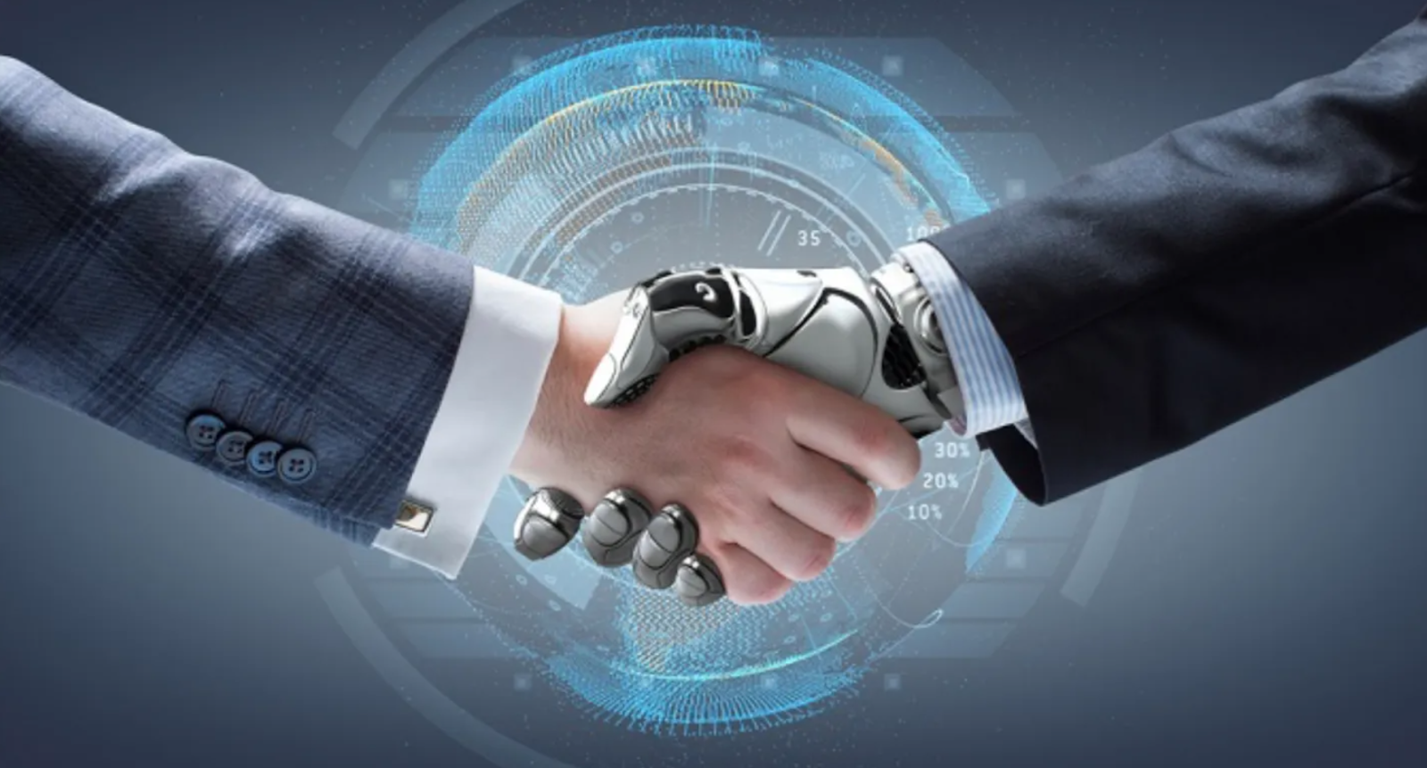
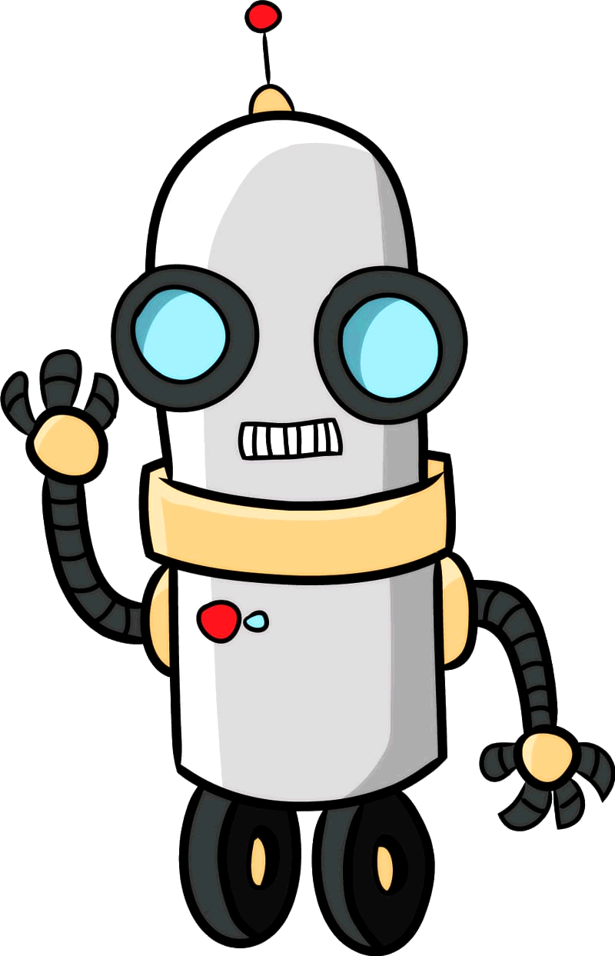
Are we concerned about AI taking over human judgement?
YES
NO
They are easy to manipulate and unregulated.
The threat is overblown but the potential is real.
AI has zero judgment, only humans have judgment?
AI is going to win against human intelligence?

Slide 12

THANK YOU!

Slide 13
THANKS!
Do you have any questions?
youremail@freepik.com
+91 620 421 838
yourcompany.com
Please keep this slide for attribution.

